Slide 1

Air quality forecasting
(Co2 Emissions)
GROUP 7
P - 81
CHIRAG VAIRAL

Slide 2

BUSINESS PROBLEM
Carbon dioxide (CO₂) emissions are the primary driver of global climate change. It is widely recognized that to avoid the worst impacts of climate change, the world needs to urgently reduce emissions.
Many industrial processes emit CO₂ through fossil fuel consumption. Several processes also produce CO₂ emissions through chemical reactions that do not involve combustion. Many industrial processes also use electricity and therefore indirectly result in CO₂ emissions from electricity generation.
CO₂ is constantly being exchanged among the atmosphere, ocean, and land surface as it is both produced and absorbed by many microorganisms, plants, and animals. Since the Industrial Revolution began around 1750, human activities have contributed substantially to climate change by adding CO₂ and other heat-trapping gases to the atmosphere.

Slide 3
BUSINESS OBJECTIVE
To forecast Co2 levels for an organization so that the
organization can follow government norms with respect to Co2 emission levels.

Slide 4
PROJECT ARCHITECTURE
DD
BUSINESS OBJECTIVE
DATA COLLECTION
EXPLORATORY DATA ANALYSIS
DATA PREPROCESSING
MODEL SELECTION
MODEL EVALUATION
MODEL DEPLOYMENT

Slide 5
Exploratory Data Analysis (EDA)

Slide 6
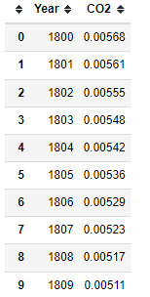
DATASET DETAILS
ROWS- 215
COLUMNS- 2
NO NULL VALUES
NO MISSING VALUES
NO DUPLICATE VALUES
NO OUTLIER
DATA IS RIGHT SKEWED
COLUMNS ‘Year' AND 'CO2' HAVE A VERY GOOD CORRELATION.

Slide 7
DATA VISUALIZATION

Slide 8
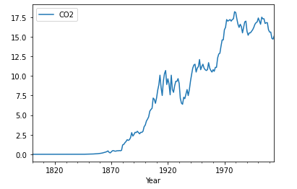
Line Plot
Line plot tracking emission of CO2 over periods of years

Slide 9
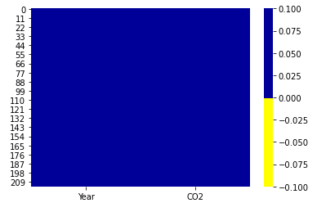
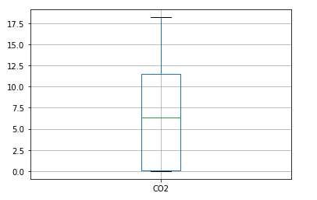
HEATMAP
Heat Map shows No missing values are present in the dataset
BOXPLOT
Boxplot shows No outliers are present in the dataset

Slide 10
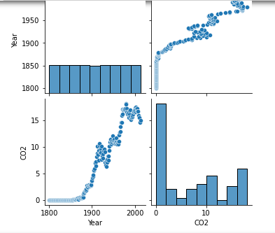
PAIRPLOT
Pair plot showing relationship between Year and CO2 columns

Slide 11
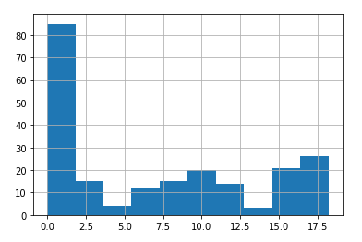
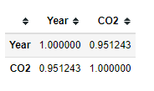
HISTOGRAM
Histogram showing that Data is right skewed
CORRELATION MATRIX
Correlation Matrix shows Columns Year and CO2 have a very good correlation

Slide 12
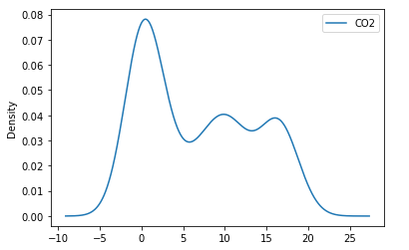
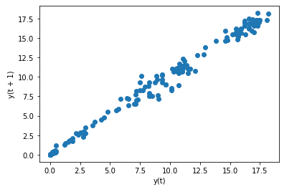
DENSITY PLOT
Density Plot shows Distribution of data
SCATTER PLOT
Scatter Plot shows Strong positive linear correlationship between variables

Slide 13
Time Series Prediction Models
Forecasting Models(Non-Stationary Data):
Simple Exponential Smoothing
Holt’s Method for Exponential Smoothing
Holts winter exponential smoothing with additive seasonality and additive trend
Holts winter exponential smoothing with multiplicative seasonality and additive trend
Holts winter exponential smoothing with multiplicative seasonality and multiplicative trend
Linear Model
Exponential Model
Quadratic Model
ARIMA Model

Slide 14
DATA PARTITION
DATA(215)
Train(175)
Test(40)

Slide 15
Holt-Winters’ Seasonal Method
The Holt-Winters model extends Holt to allow the forecasting of time series data that has both trend and seasonality, and this method includes this seasonality smoothing parameter.
There are two general types of seasonality: Additive and Multiplicative.
Additive: = Trend + Seasonal + Random Seasonal changes in the data stay roughly the same over time and don’t fluctuate in relation to the overall data.
Multiplicative= Trend * Seasonal * Random The seasonal variation changes in relation to the overall changes in the data. So, if the data is trending upward, the seasonal differences grow proportionally as well.

Slide 16
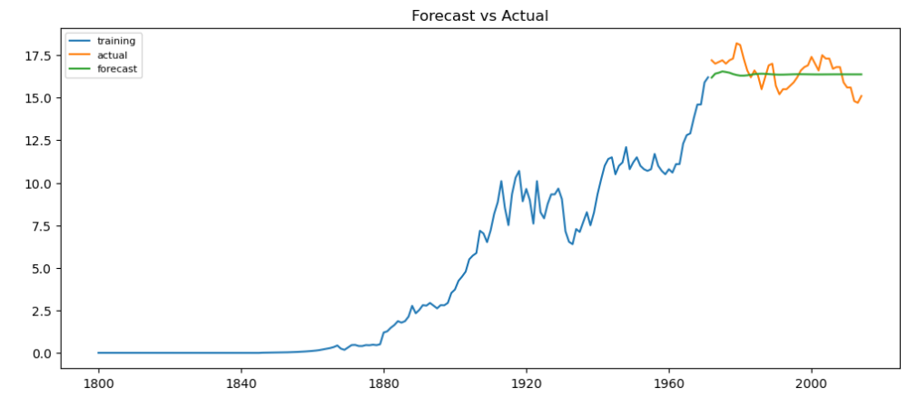
ARIMA Model (Non Stationary Data)
RMSE Value= 0.8483
MAPE Value= 0.0444

Slide 17
Forecasting Models(Stationary Data):
ARIMA Model
Auto Regressor Model
Moving Average Model

Slide 18
ARIMA Model(Stationary Data )
ARIMA, short for ‘Auto Regressive Integrated Moving Average’ is actually a class of models that ‘explains’ a given time series based on its own past values, that is, its own lags and the lagged forecast errors, so that equation can be used to forecast future values.
We have performed Grid search for hyper-parameters to find out optimal
order or (p, d ,q) for ARIMA model(Stationary Data).

Slide 19
ARIMA Model(Stationary Data )
Best order found is (0,1,0) with least RMSE
FINAL MODEL
We have selected ARIMA(0,1,0) as our final model because it has least MAPE value

Slide 20
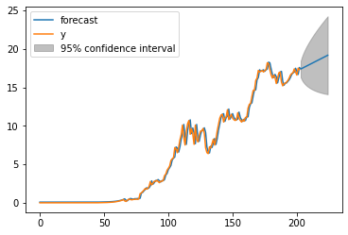
FINAL ARIMA MODEL

Slide 21
Forecasting for next 10 years
2015-01-01 17.35
2016-01-01 17.47
2017-01-01 17.55
2018-01-01 17.64
2019-01-01 17.72
2020-01-01 17.81
2021-01-01 17.89
2022-01-01 17.98
2023-01-01 18.06
2024-01-01 18.15

Slide 22
DEPLOYMENT

Slide 23
DEPLOYMENT
We have deployed the final model using Streamlit
Steps to run python application:
Open Anaconda Prompt
Then run command : streamlit run Forecast.py
After opening of browser choose number of years you want to forecast
Forecasted results and graph will be displayed

Slide 24
CONCLUSION
We have applied some Time Series Forecasting Models to the given CO2 dataset.
After applying some Forecasting models to the given dataset ,we have found that MODEL ARIMA gives good time series forecasting for CO2 emission.
Therefore, We have deployed ARIMA MODEL on Streamlit Cloud Platform.

Slide 25
Thank you!

